Slide 1

TEAM UNDEPLOYED PRESENTS
BBM - Bus Bani Metro
An IoT based take to revolutionize the public transport industry

Slide 2
What We'll Discuss
TOPIC OUTLINE
The Problem
The Solution
The Approach
The Outcomes
The tech stack
The Future
TEAM UNDEPLOYED

Slide 3

Before we begin
WHAT ARE THE PROBLEMS?
Congestion on roads due to over-traffic
No data driven approach to identify problems
No reliability of public transport
No details with the rider leading to lesser safety
TEAM UNDEPLOYED

Slide 4

PONDER ON THIS
THE ANSWER LIED IN FRONT OF US. WHY IS METRO SO POPULAR BUT BUSES AREN'T.

Slide 5
What is Our Solution?
We propose an IoT piggybacking system which uses any available network to transmit real time location and time of a bus
We can calculate delay/ furtherance of a bus from scheduled time
Real time setting up of routes for better planning with updation on app
Data from shockers helps us judge road conditions, slow movement helps us determine improper traffic time or bottlenecks, etc.
IDEATE, PROTOTYPE,
TEST, REPEAT

Slide 6





THE APPROACH
EMPATHISE WITH THE CUSTOMER
THE THINGS
THE DATA
TRIAL AND TEST
The data is send over to cloud and using UIPath the next day's charts are generated
Each bus has an IoT module which sends us, stores data of location wrt time so that people get updates
People now see buses as a reliable, safe and regular source helping us solve two problems
Understand the reasons why people do not prefer bus and do prefer metro
TEAM UNDEPLOYED

Slide 7


90%
10%
Cost saving
Expenditure
TEAM UNDEPLOYED

Slide 8
SOME TOOLS
NODE MCU
AZURE
UIPATH
ANDROID
WiFi module to piggyback data to the server.
It provides the system various dynamic features like Azure translator text and Cosmos DB.
The automation task of retrieving DTC's daily routine is done using UI Path
excel automation.
Integrated platform for the end user for delay notifications and planned commutation.
TEAM UNDEPLOYED

Slide 9
SHORTEST TIME
Best Services
Rapid Prototyping
LEAST COST
Cheap alternative
SIMPLEST MODEL
Easy to install and monitor
TEAM UNDEPLOYED

Slide 10
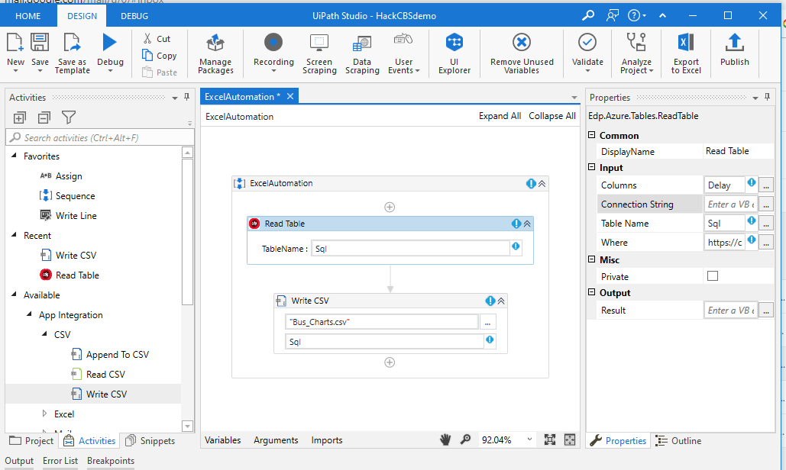
UIPath
TEAM UNDEPLOYED

Slide 11
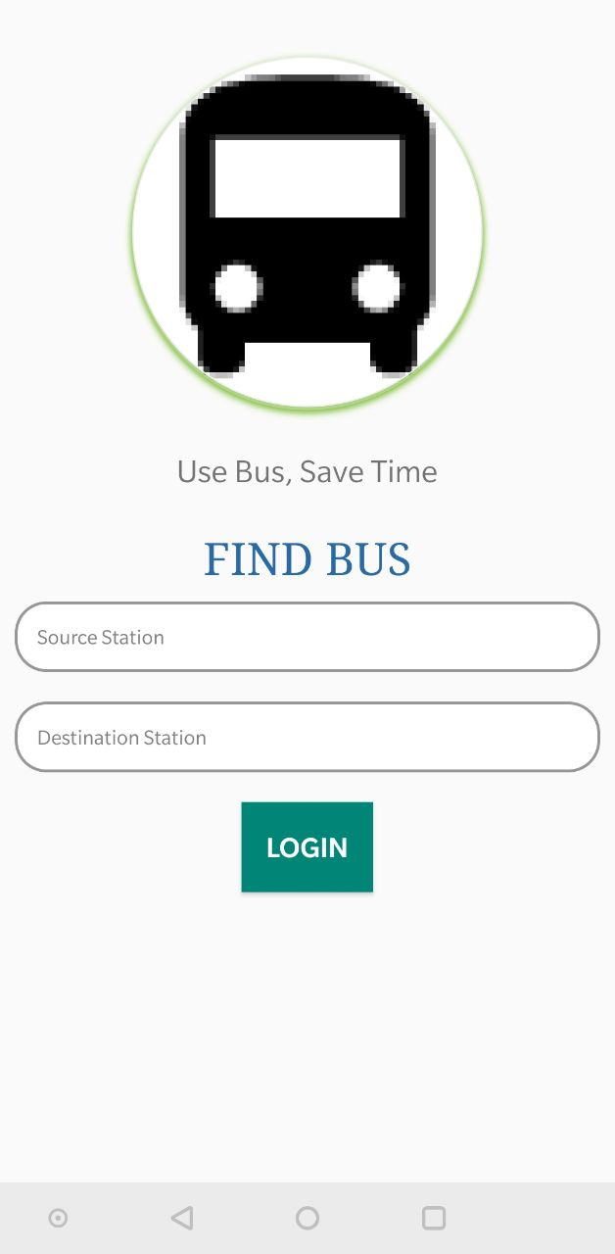
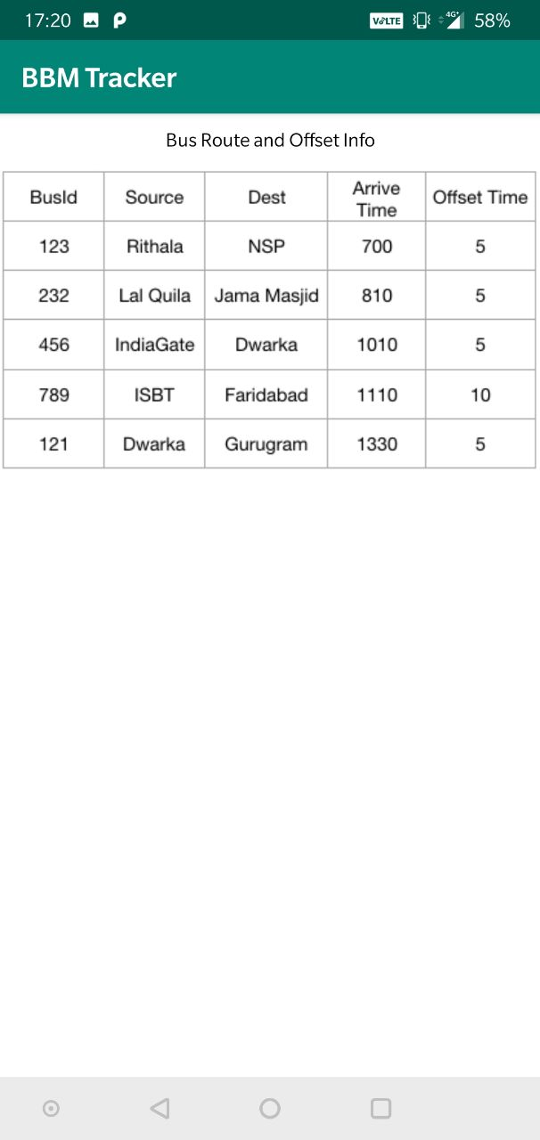
App Prototype
TEAM UNDEPLOYED

Slide 12
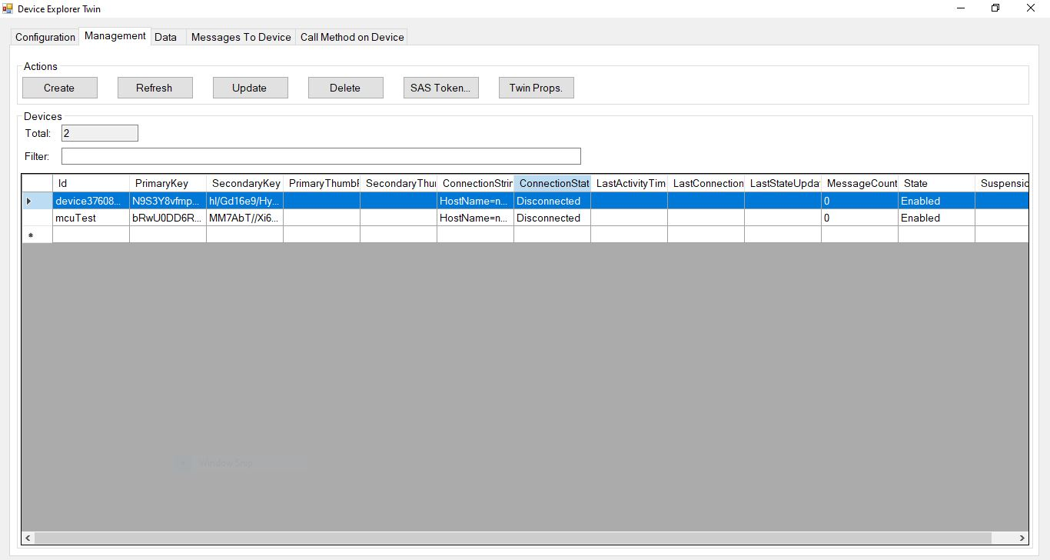
IoT SDK - Azure
TEAM UNDEPLOYED

Slide 13
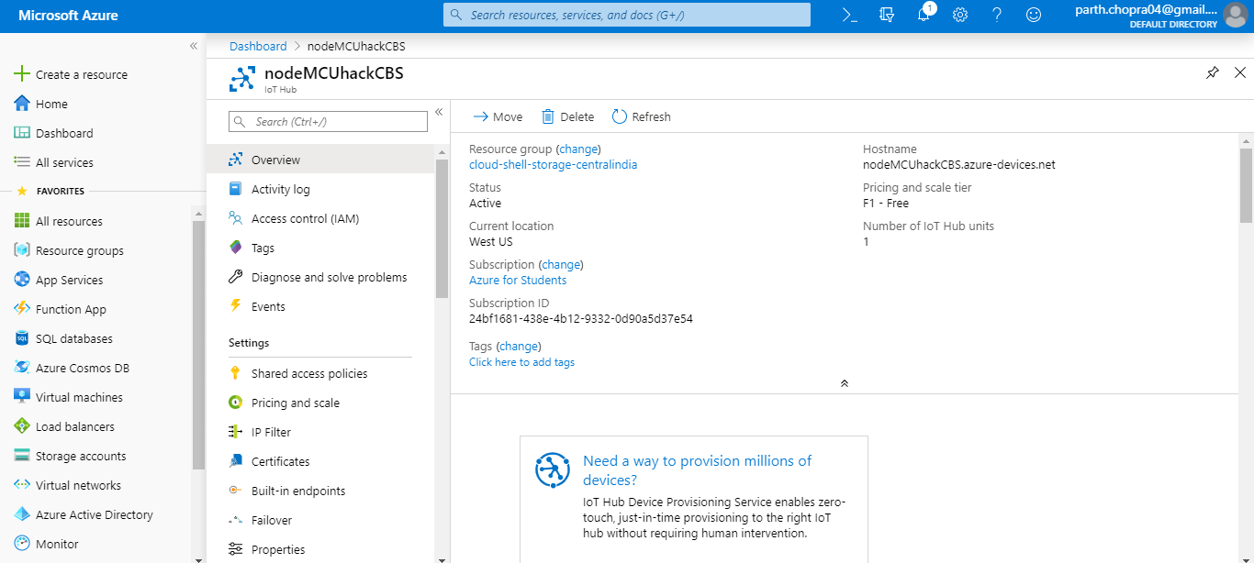
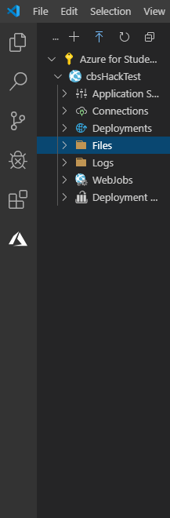
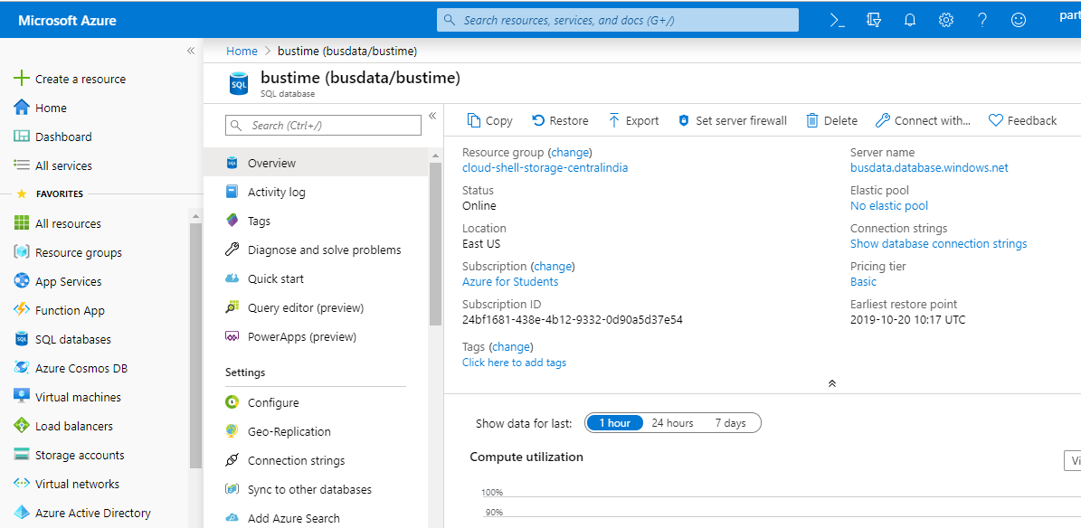
Azure
TEAM UNDEPLOYED

Slide 14
40
30
5-Year Projections
20
10
0
Item 1
Item 2
Item 3
Item 4
Item 5

Slide 15
We'd love to chat!
ASK US ANYTHING!
TEAM NUMBER
1.039.4
EMAIL
joyendraroybiswas@gmail.com
TEAM
Undeployed

